Slide 1
Next Generation Sequencing An Overview

Slide 2
What is sequencing?

Slide 3
DEFINITION
“In genetics and biochemistry, sequencing means to determine the primary structure (or primary sequence) of an unbranched biopolymer.”

Slide 4
Principle
SYNTHESIS of DNA is randomly TERMINATED at different points
Separation of fragments that are 1 nucleotide different in size

Slide 5
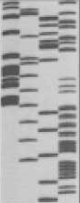
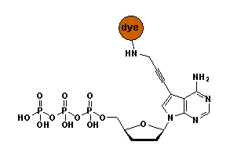
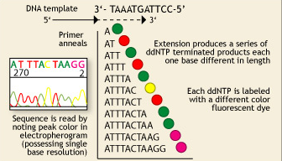
Sanger’s sequencing
P³² labelled ddNTPs
!
Lack of OH-group at 3’ position of deoxyribose
Fluorescent dye terminators
Max fragment length – 750 bp

Slide 6
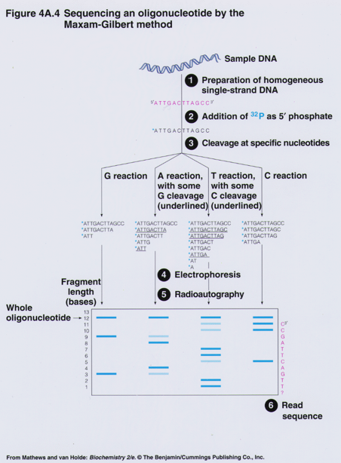
Maxam & Gilbert Sequencing

Slide 7

Sequencing genomes using Sanger’s method
Extract & purify genomic DNA
Fragmentation
Make a clone library
Sequence clones
Align sequencies ( -> contigs -> scaffolds)
Close the gaps
Cost/Mb=1000 $, and it takes TIME

Slide 8
Major NGS technologies

Slide 9
NGS technologies
Company | Platform | Amplification | Sequencing method
Roche | 454** | emPCR | Pyrosequencing
Illumina | HiSeq MiSeq | Bridge PCR | Synthesis
LifeTech | SOLiD** | emPCR/ Wildfire | Ligation
LifeTech | Ion Torrent Ion Proton | emPCR | Synthesis (pH)
Pacific Bioscience | RSII | None | Synthesis
Complete genomics | Nanoballs | None | Ligation
Oxford Nanopore* | GridION | None | Flow

Slide 10

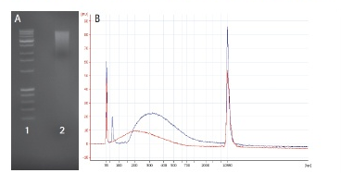
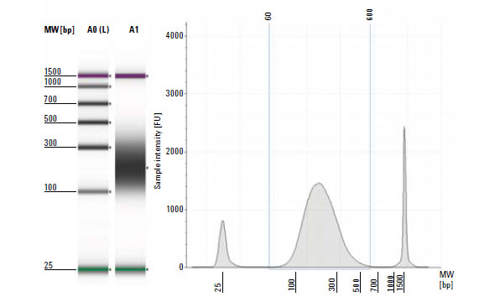
Making a NGS library
DNA QC – paramount importance
Sharing & size selection
Amplification
Ligation of sequencing adaptors, technology specific

Slide 11
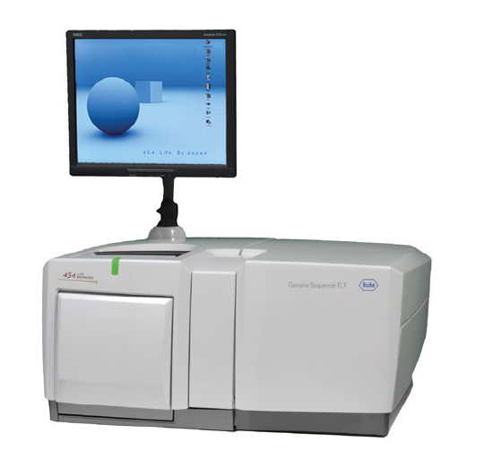
Roche
Instrument | Yield and run time | Read Length | Error rate | Error type
454 FLX+ | 0.9 GB, 20 hrs | 700 | 1% | Indels
454 FLX Titanium | 0.5 GB, 10 hrs | 450 | 1% | Indels
454 FLX Jr | 0.050 GB, 10 hrs | 400 | 1% | Indels
Main applications:
Microbial genomics and metagenomics
Targeted resequencing

Slide 12
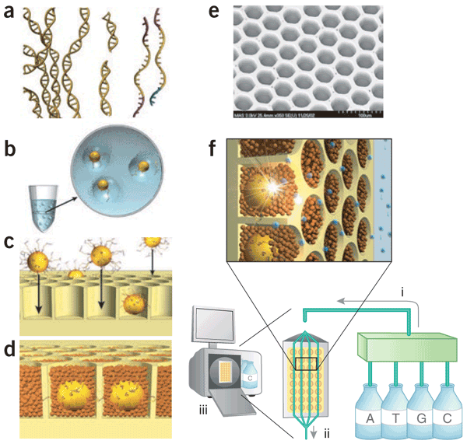
454 Titanium GS FLX

Slide 13
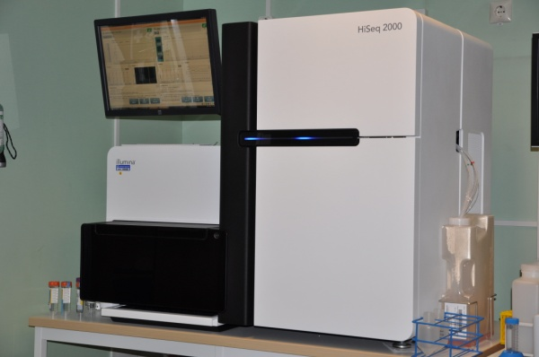
Illumina
Instrument | Yield and run time | Read Length | Error rate | Error type
Upgrade HiSeq2500 | 120 GB in 27h or standard run | 100x100 | 0.1% | Subst
MiSeq | 540 Mb – 15 Gb (4 – 48 hours) | Upp to 350x350 | 0.1% | Subst
Main applications
Whole genome, exome and targeted reseq
Transcriptome analyses
Methylome and ChiPSeq
Rapid targeted resequencing (MiSeq)

Slide 14
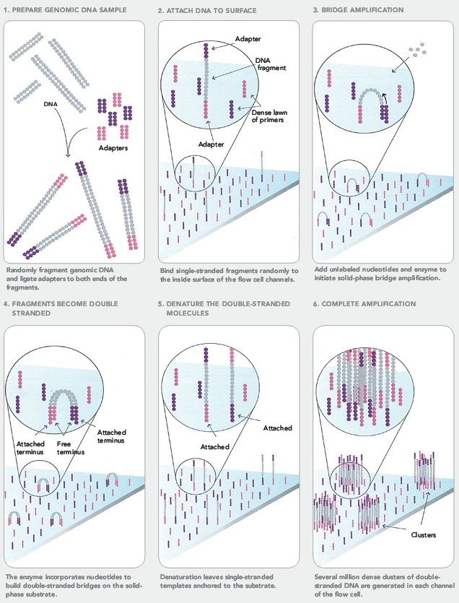
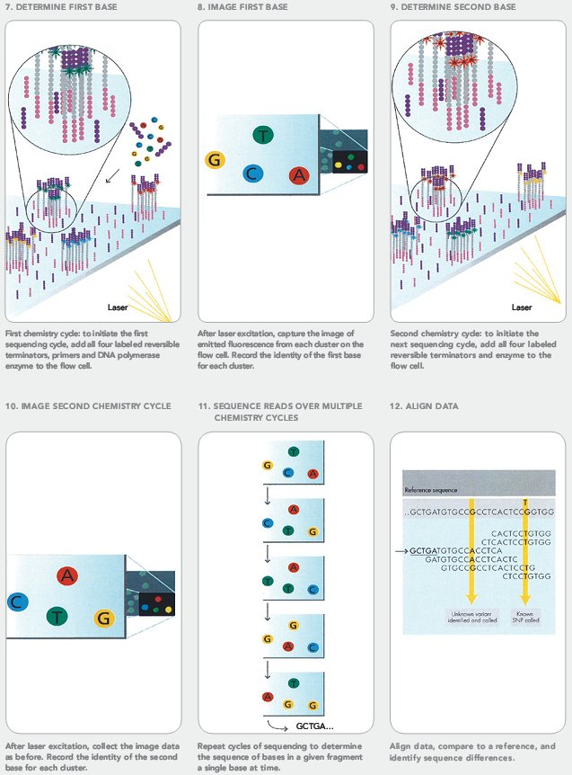
Illumina

Slide 15
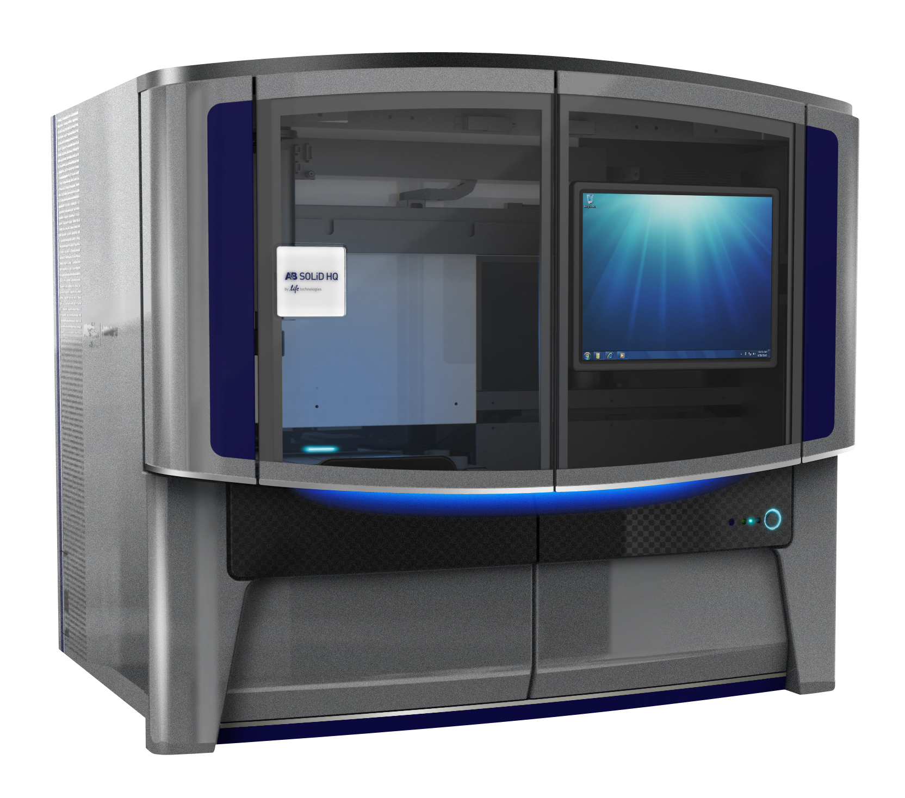
Life Technologies SOLiD
Instrument | Yield and run time | Read Length | Error rate | Error type
SOLiD 5500 wildfire | 600 GB, 8 days | 75x35 PE 60x60 MP | 0.01% | A-T Bias
Features
High accuracy due to two-base encoding
True paired-end chemistry - ligation from either end
Mate-pair libraries
Main applications (currently)
ChiPSeq

Slide 16
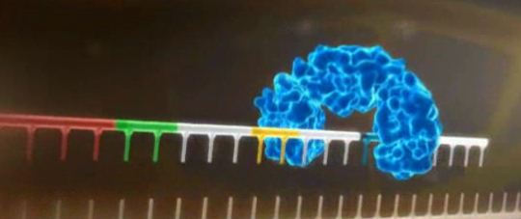
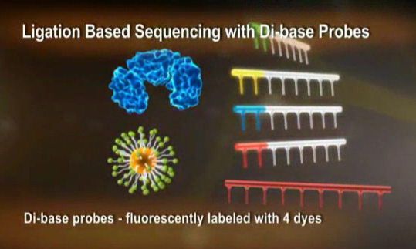
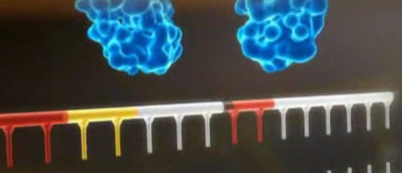
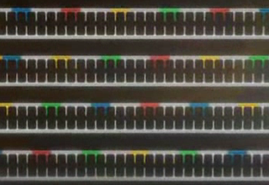
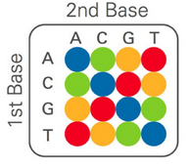
SOLiD - ligation

Slide 17
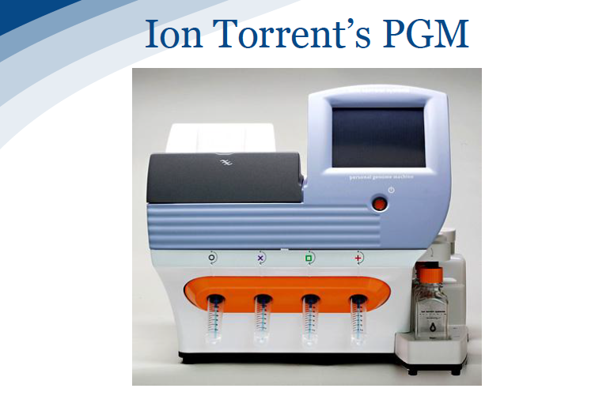
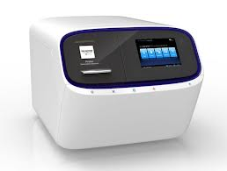
Life Technologies - Ion Torrent & Ion Proton
Chip | Yield - run time | Read Length
PGM 314 | 0.1 GB, 3 hrs | 200 – 400
PGM 316 | 0.5GB, 3 hrs | 200 - 400
PGM 318 | 1 GB, 3 hrs | 200 - 400
P-I | 10 GB | 200
Main applications
Microbial and metagenomic sequencing
Targeted resequencing
Clinical sequencing

Slide 18
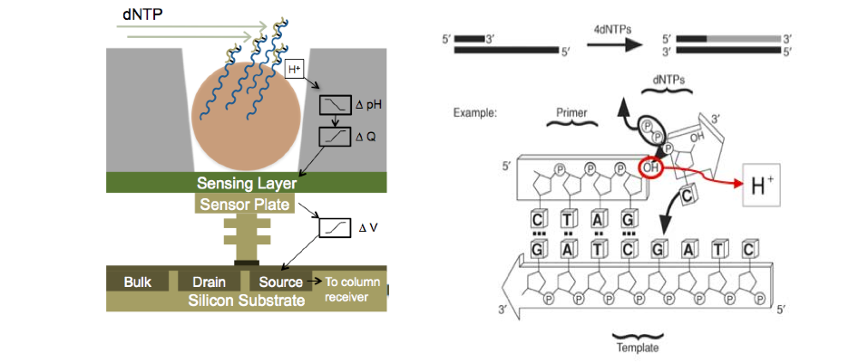
Ion Torrent - H⁺ ion-sensitive field effect transistors

Slide 19
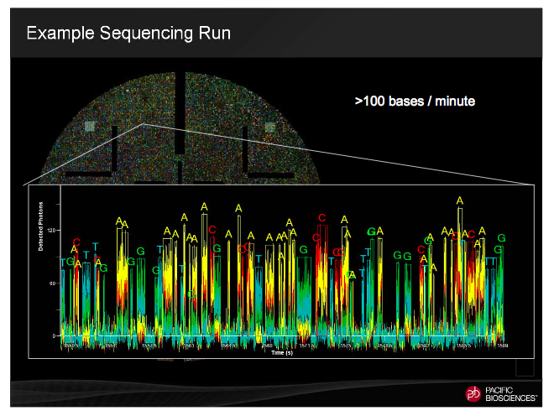
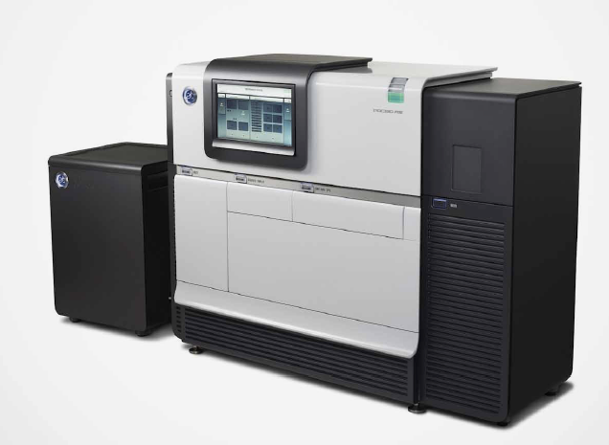
Pacific Bioscience
Instrument | Yield and run time | Read Length | Error rate | Error type
RS II | 500 MB/180 min SMRTCell | 250 bp – 20 000 bp (35 000 bp) | 15% (on a single passage!) | Insertions, random
Single-Molecule, Real-Time DNA sequencing

Slide 20
NGS technologies - SUMMARY
Platform | Read length | Accuracy | Projects / applications
454 | Medium | Homo- polymer runs | Microbial + targeted reseq
HiSeq MiSeq | Short Medium | High | Whole genome + transcriptome seq, exome
SOLiD | Short | High | Whole genome + transcriptome seq, exome
Ion Torrent | Medium | High | Microbial + targeted reseq
Ion Proton | Short/Medium | High | Exome, transcriptome, genome
PacBio | Long | Low – ultra high* | Microbial + targeted reseq Gap closure & scaffolding

Slide 21
 | Illumina HiSeq | Illumina MiSeq | SOLiD Wildfire | Ion Torrent | Ion Proton | PacBio
Read length | 100 + 100 bp (150+150 bp) | 250 + 250 bp (350+350 bp) | 75 bp | 200 bp 400 bp (500 bp) | 150 bp 200 bp | 1 – 20 Kbp
WGS: - human - small | ++++ +++ | +++ | (+) (+) | ++++ | + +++ | (+) +++++
De novo | +++ | ++ |  | +++ | ++ | +++++
RNA-seq miRNA | +++ +++ |  | +++ +++ |  | +++ | +++*
ChIP | +++ |  | ++++
Amplicon | ++ | +++ |  | +++ | +++ | +++
Metylation | +++ |  |  |  |  | ++++*
Target re-seq | ++ | +++ | (+) |  | +++ | +++
Exome | +++ |  | (+) |  | ++++ | (+)

